Slide 1
Mechanisms and Robotics DE ES ZG561
Lecture-3

Slide 2
Fundamentals of Robot Technology
Robot Specifications
Analysis & modelling of mechanisms
Mechanisms
Spatial Mechanisms
Four bar planar and Spatial Mechanisms

Slide 3
Manipulation and Control
In the analysis of spatial mechanisms (manipulators), the location of links, joints and end effector in 3-D space is continuously required.
These need to be calculated using mathematical methods.
To describe the position and orientation of a body in space a frame or a coordinate system is attached to the body
The position and orientation of this frame with respect to a reference frame, mathematically describes the location of the body.

Slide 4
Robot Specifications
Drive System
Electrical
Hydraulic
Pneumatic
Speed of Motion
Load-Carrying Capacity (Pay – Load)
Control Systems
Precision of Movement
Spatial Resolution
Accuracy
Repeatability
Work Volume

Slide 5
Drive System
Hydraulic drive: gives a robot great speed and strength. These systems can be designed to actuate linear or rotational joints. The main disadvantage of a hydraulic system is that it occupies floor space in addition to that required by the robot.
Electric drive: compared with a hydraulic system, an electric system provides a robot with less speed and strength. Accordingly, electric drive systems are adopted for smaller robots. However, robots supported by electric drive systems are more accurate, exhibit better repeatability, and are cleaner to use.
Pneumatic drive: are generally used for smaller robots. These robots, with fewer degrees of freedom, carry out simple pick-and-place material handling operations.

Slide 6
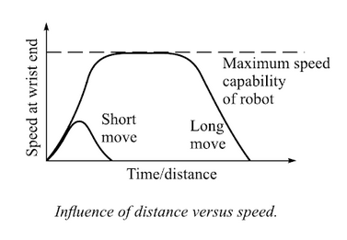
Speed of Motion
Maximum speed of 500 degrees/second can be achieved.
Highest speed can be achieved by large robots with arm extended fully.
Hydraulic robots tend to be faster than electric drive robots.
Robots with electric drives have better control.
Selection of the most desirable speed also depends on
Accuracy of positioning of the object
Weight of the object to be handled
Distances to be moved.

Slide 7
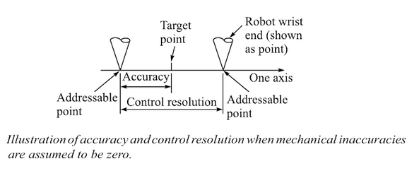
Spatial Resolution, Accuracy, Precision
Spatial Resolution is the smallest increment of movement into which the robot can divide its work volume.
Accuracy refers to a robot’s ability to position its wrist at a target point within its work volume.

Slide 8
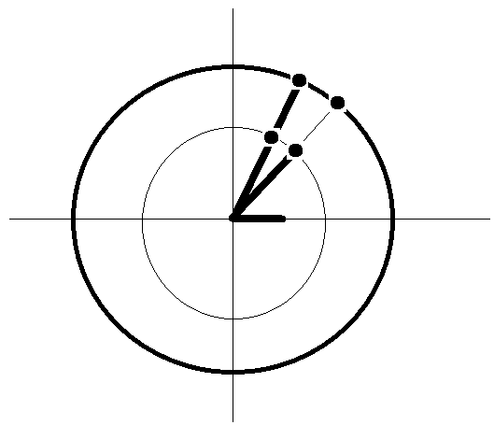
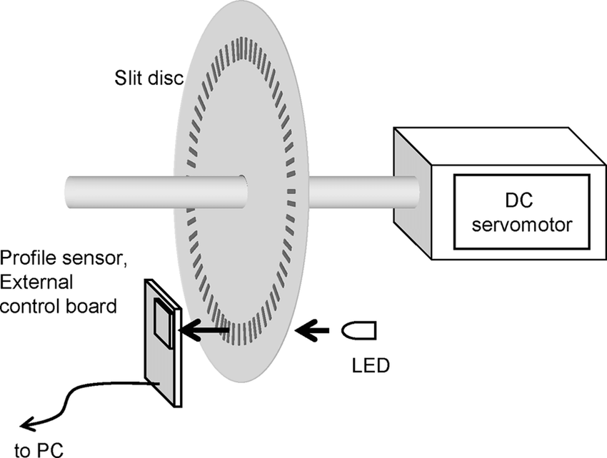
Spatial Resolution, Accuracy, Repeatability

Slide 9
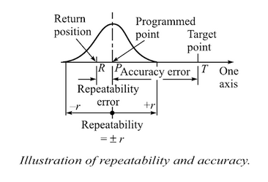
Spatial Resolution, Accuracy, Precision
Repeatability is the ability of the robot to position its wrist at a point in space that had previously been taught to the robot.

Slide 10
Load Carrying Capacity
The load the robot can carry at its weakest position without including the weight of the end effector, while maintaining its specified accuracy.
Effective/Net load carrying Capacity =
(Load carrying capacity – weight of the end effector)@ the weakest position

Slide 11
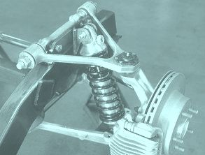
Mechanisms
Kinematic Link: Each part of a machine, which moves relative to some other part is known as a kinematic link or link or element.
Types of Links:
Rigid Link
Flexible Link
Fluid Link
Structure: Assemblage of resistant bodies having no relative motion between them and meant for carrying loads.
Kinematic Pair: The two links or elements of a machine, when in contact with each other if the relative motion between them is completely constrained, the pair is known as kinematic pair.

Slide 12
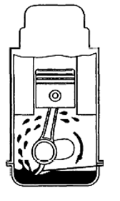
Mechanisms
Kinematic Chain: When the kinematic pairs are coupled in such a way that the last link is joined with the first link to transmit definite motion, it is called kinematic chain (Closed).
Mechanism: When one of the links in a kinematic chain is fixed, the chain is known as a mechanism.
Machine: When a mechanism is required to transmit power or do some particular work, it is called a machine.

Slide 13
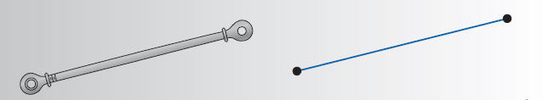
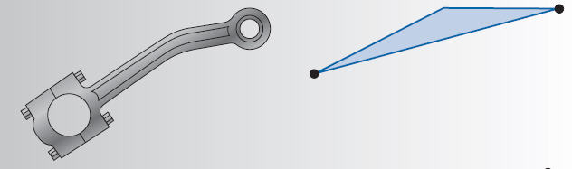
Links and Kinematic symbols
Simple Link
Simple Link
with Point of interest

Slide 14
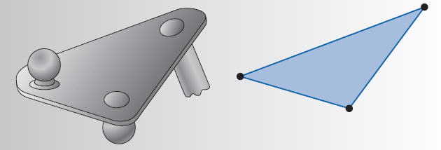
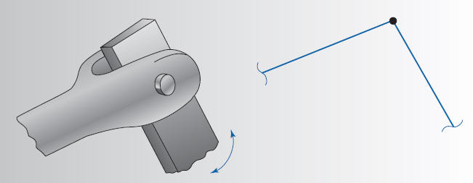
Links and Kinematic symbols
Complex Link
Pin Joint

Slide 15
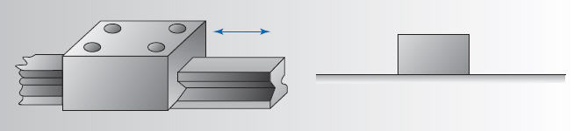
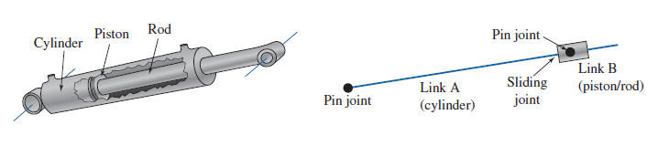
Links and Kinematic symbols
Slide Joint

Slide 16
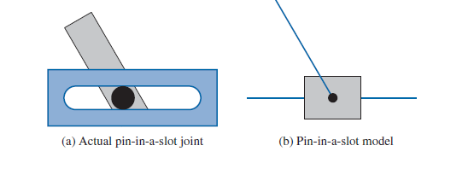
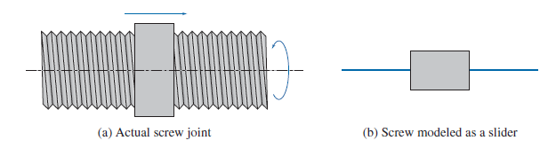
Links and Kinematic symbols

Slide 17
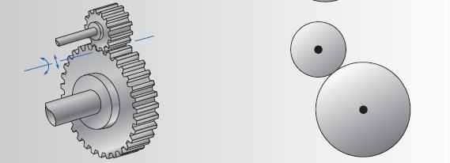
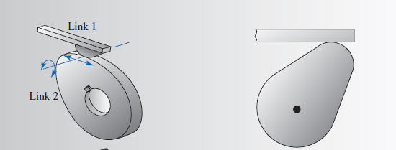
Links and Kinematic symbols
Gear pair
Cam and Follower

Slide 18
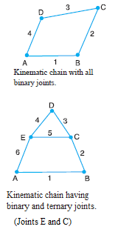
Kutzbach criterion
m = 3(l - 1) - 2j – h
j = number of binary joints
l = no. of links
h – no of higher pairs (Cams and Gears).
m – mobility, degree of freedom
Binary joint. When two links are joined at the same connection, the joint is known as binary joint.
Ternary joint. When three links are joined at the same connection, the joint is known as ternary joint. It is equivalent to two binary joints as one of the three links joined carry the pin for the other two links
When h = 0, Kutzbach criterion becomes Grubler’s Equation

Slide 19
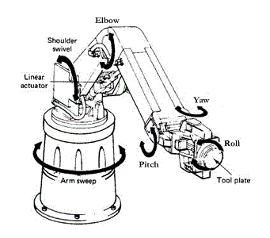
Robot Construction
A robot is mechanically constructed by connecting a set of bodies, called links, to each other using various types of joints.
Actuators, such as electric motors, deliver forces or torques to the joints that cause the robot’s links to move.

Slide 20
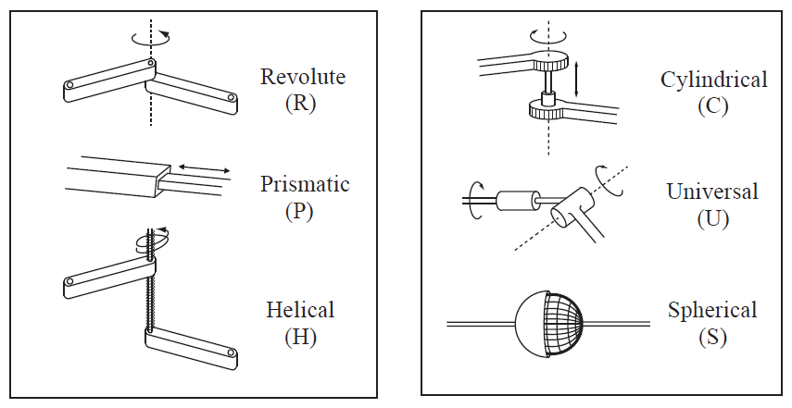
Joint types

Slide 21
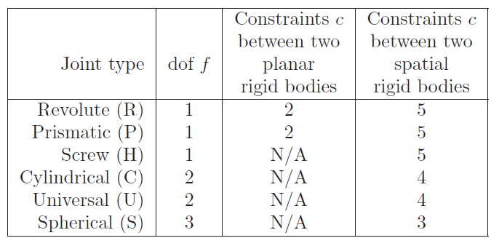
Joint dof

Slide 22
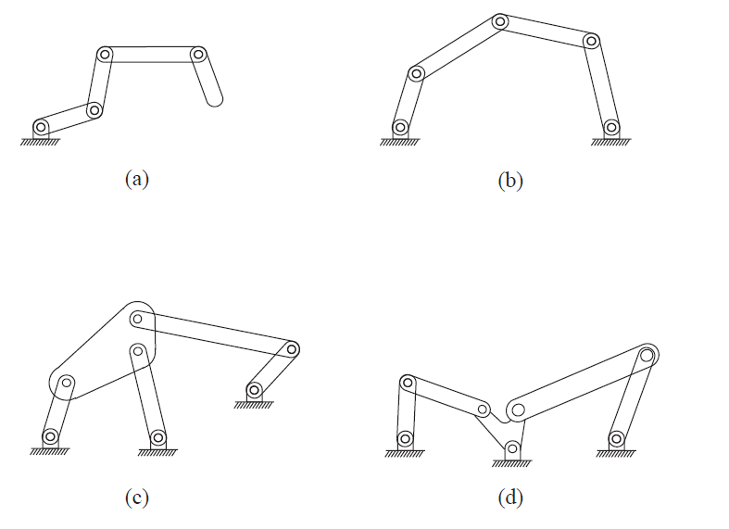
Find the degrees of freedom

Slide 23
Find the degrees of freedom
Dof = 4
Dof = 2
Dof = 1
Dof = 1

Slide 24
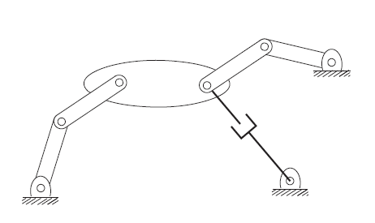
Find the degrees of freedom

Slide 25
Find the degrees of freedom
N = 8
J = 9
Dof = 3

Slide 26
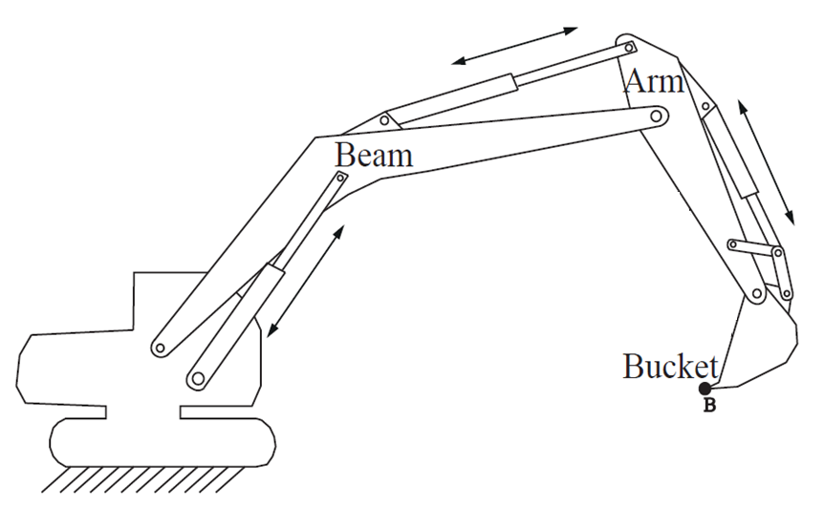
Find the degrees of freedom

Slide 27
l = 12
j = 15
Dof = 3

Slide 28
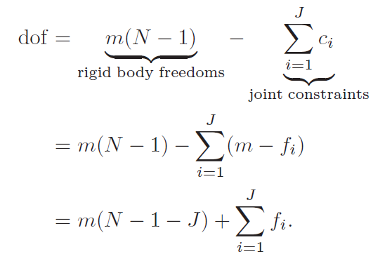
Gr¨ubler’s formula for degrees of freedom
Consider a mechanism consisting of N links, where ground is also regarded as a link. Let J be the number of joints, m be the number of degrees of freedom of a rigid body.
(m = 3 for planar mechanisms and
m = 6 for spatial mechanisms)
fi be the number of degrees of freedom provided by joint i, and ci be the number of constraints provided by joint i (it follows that fi + ci = m for all i).
Then Gr¨ubler’s formula for the degrees of freedom (dof) of the robot is

Slide 29
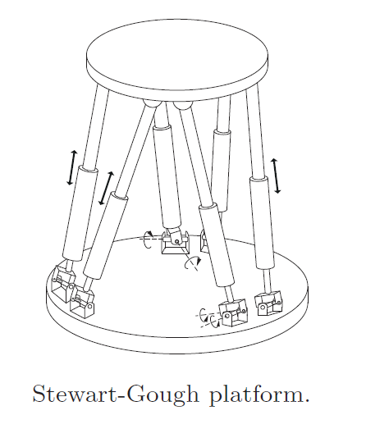
Find the dof
The Stewart-Gough platform consists of two platforms—the lower one stationary and regarded as ground, the upper one mobile—connected by six universal-prismatic-spherical (UPS) serial chains.

Slide 30
Find the dof
The Stewart-Gough platform consists of two platforms—the lower one stationary and regarded as ground, the upper one mobile—connected by six universal-prismatic-spherical (UPS) serial chains.
N =14
J = 18
Dof = 6

Slide 31
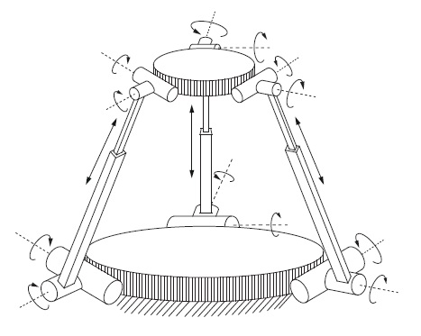
Find the dof

Slide 32
Find the dof
N= 8
J = 9
Fi = 15
Dof = 3

Slide 33
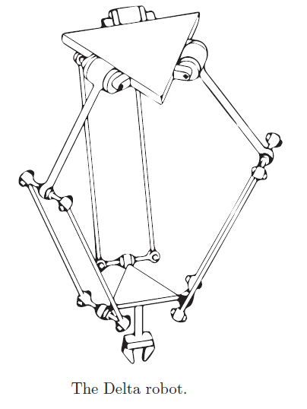
Find the dof

Slide 34
Find the dof
Each parallelogram linkage has one degree of freedom of motion, so that each leg of the Delta robot is kinematically equivalent to an RUU chain.
L= 8
J = 9
Fi = 15
Dof = 3

Slide 35
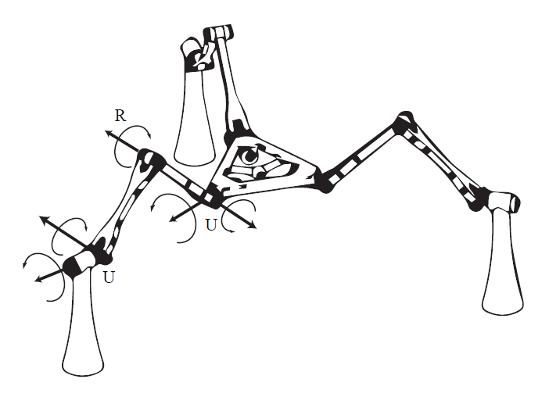
Find the dof

Slide 36
Find the dof

Slide 37
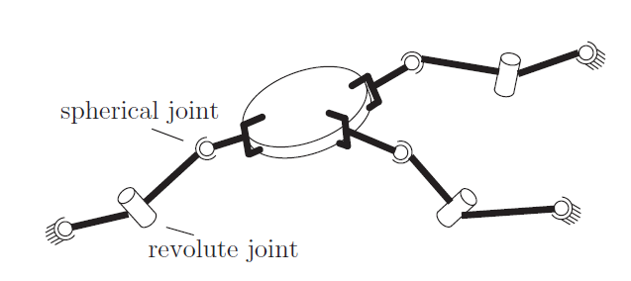
Home Work

Slide 38
THANK YOU
The presenter is grateful to the authors of the following text books for their wonderful work.
Machines and Mechanisms, Applied Kinematic Analysis (Fourth Edition) – David H. Myszka
Industrial Robotics - Mikell P. Groover
Fundamentals of Robotics – Robert Schilling
INTRODUCTION TO ROBOTICS MECHANICS, PLANNING, AND CONTROL- F. C. Park and K. M. Lynch
Modern Robotics: Mechanics, Planning, and Control," Kevin M. Lynch and Frank C. Park, Cambridge University Press, 2017.
Theory of Machines, R.S. Khurmi.

